Slide 1
MVC VIEW ENGINES

Slide 2
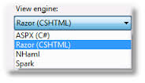
What is a view engine:
View Engines are responsible for rendering the HTML from your views to the browser.
The view engine template will have different syntax for implementation.
currently there are few number of view engines are available for mvc.If u really want you can use multiple view engines in parallel in ASP.net MVC.

Slide 3
View engines
For example, ASP.NET comes with its own view engine out of the box. That is the one where views have lots of tags like <% %> and <%: %>. It uses the .aspx file extension.
With ASP.NET MVC3, another out-of-the-box view engine was added, Razor, which has a more appealing syntax, e.g. <div>@Model.UserName</div>.

Slide 4
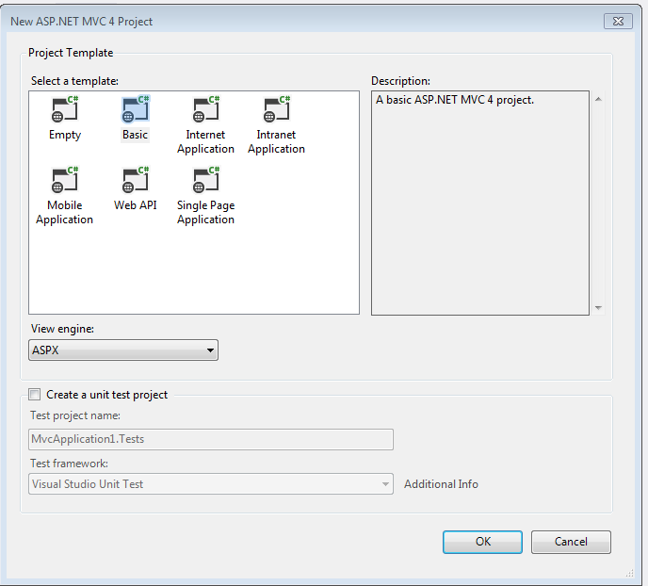
How to set a view engine in mvc
Open a new project and select Asp.net Mvc Web application.In the view engine options we can select the view engines.

Slide 5
Razor view Engine
The Razor view engine is an advanced view engine from Microsoft, packaged with MVC 3. Razor using an @ character.
Razor is a markup syntax that lets you embed server-based code into web pages
It is not a programming language. It is a server side markup language.
You can use Razor engine anywhere to generate output like HTML
The namespace for Razor Engine is System.Web.Razor

Slide 6
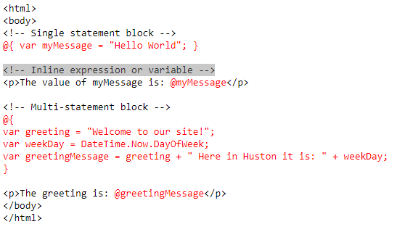

Example for Razor View Engine
Source Result

Slide 7
ASPX view engines
The ASPX style view engine dates back to classic ASP. Place holders using the <%= %> or newer <%: %> syntax predominate this style. Over time ASPC controls were added and then master pages, but this also brought with it an expensive page life-cycle.
sample code is:
<h1>Sample with ASPX </h1>
<h3>
Hello <%=name %>, the year is <%= DateTime.Now.Year %>
</h3>
<p>
checkout <a href="/Products/Details/<%=produtid %>">this product</a>
</p>

Slide 8
Spark view engine
Spark, Spark is a view engine for ASP.NET MVC While it does support placeholders, it also freely mixes HTML and code using special attributes and tags.
<h1>Sample with Spark</h1>
<ul>
<li each='var p in ViewData.Model.Products'>
${p.Name} !{Html.ActionLink[[ProductController]](c=>c.Edit(p.Id), "Edit")}
</li>
</ul>

Slide 9
Hasic
Hasic uses VB.NET's XML literals instead of strings like most other view engines. Sample code is given below,
<h2>Sample with Hasic</h2>
<%= Model.Message.AsForm(Function(m) _
<form method="post" action="/home/messages">
<%= m.Sender.Label("Enter your name") %>
<%= m.Text.TextArea().Label("Enter your message") %>
<button type="submit">Send</button>
</form>) %>

